Slide 1


Joel Brodzinski
Nate Benson

Slide 2
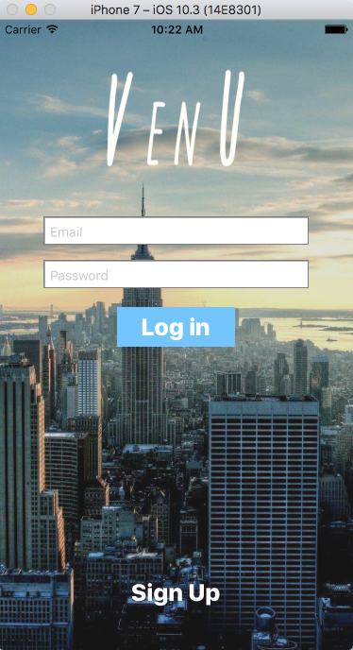
What is VenU?
VenU is an event organizer app that allows you, the user, to create and look for events and venues in your area. These events are hosted by venues that can give you deals and coupons for hosting your event with them.

Slide 3
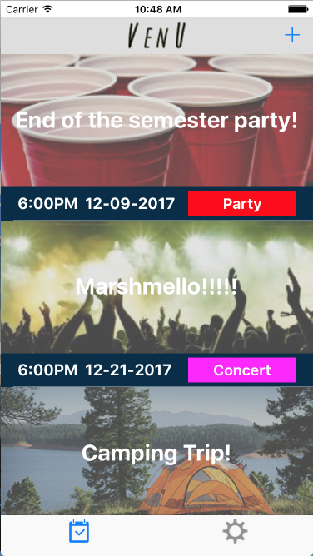
How Do I Use VenU?
VenU has a simplistic application layout with a dashboard of all public events in your area. Events are categorized based on type of event

Slide 4
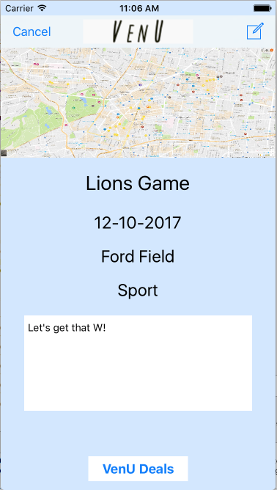
How Do I Use VenU?
Each event has details that can be viewed to get further information. This details view also hosts a ‘VenU Deals’ button that will lead to a venue’s current deals.

Slide 5
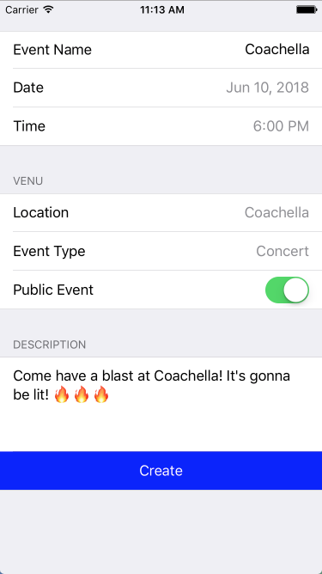
How Do I Use VenU?
You are able to create your own events by setting a name, date, time, location, event type, if it’s public, and a description. All entries are uploaded to Firebase so all users in an area get the same events

Slide 6
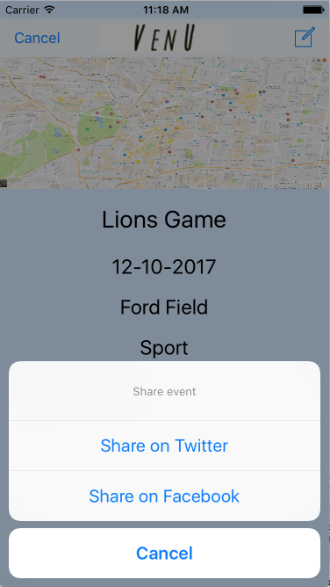
How Do I Use VenU?
Any event that you may find interesting or want others to attend can be shared to Twitter and/or Facebook.

Slide 7
Demo

Slide 8
Get VenU today!

